Slide 1
Professionalism: Roles and Responsibilities
Ngozi Onuegbu PhD
PT5W50/PT4W50

Slide 2

Recap of Induction Week Conversations:
What does Professionalism mean to you?

Slide 3

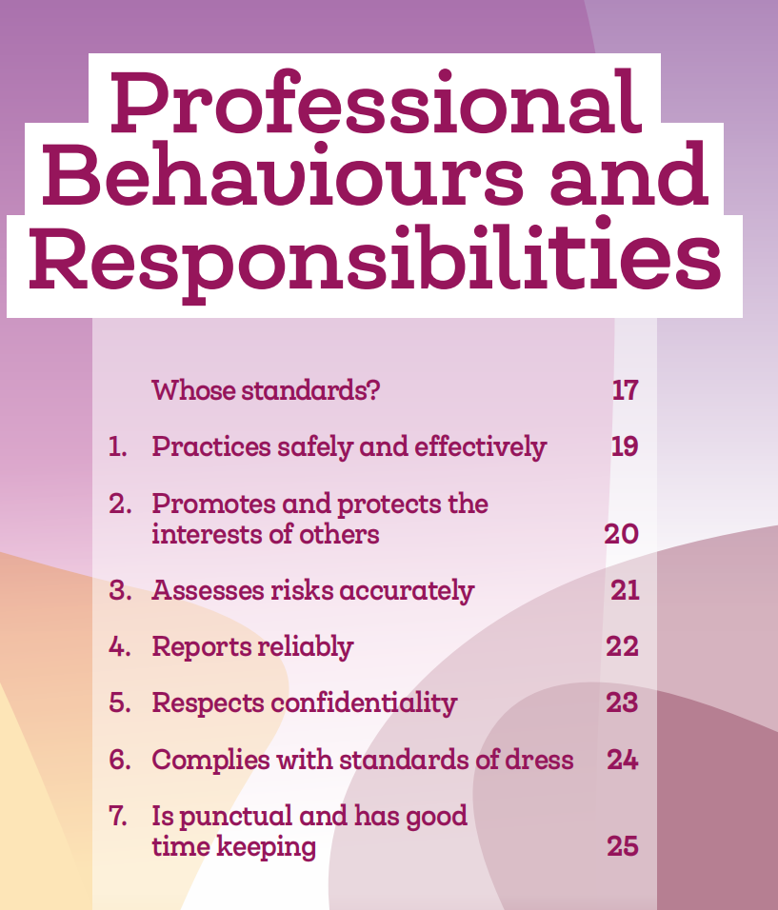
What Might you be assessed on?
Who sets the standards?
Health and Care Professions Council (HCPC)?
Chartered Society for Physiotherapy (CSP)?

Slide 4
Regulations and Professionalism:
The Health and Care Professions Council (HCPC) is the regulator for Physiotherapy profession.
Their Standards of Conduct, Performance and Ethics set out the expectations of how we should behave and what the public should expect from us.
They are an essential read, alongside their guidance document aimed specifically for students, helping you to understand the importance of your responsibilities and role (HCPC, 2023) .

Slide 5
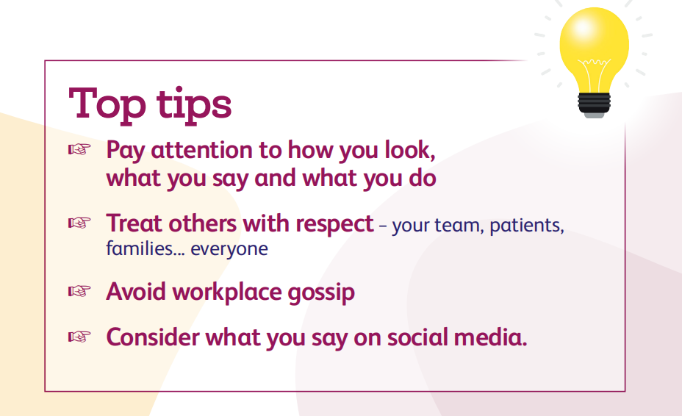
Guidance and Professionalism:
The CSP is the professional body who offer valuable guidance to the physiotherapy profession.
Their Code of Members Professional Values and Behaviour document sets out their expected standards of behaviour (CSP, 2011).

Slide 6
Professional Behaviours and Responsibilities
Professional behaviour is integral to a student physiotherapist’s development and future practice.
Aligns with the Health and Care Professions Council (HCPC) standards and Chartered Society of Physiotherapy (CSP) guidelines (HCPC, 2023; CSP, 2011).
A key aspect of demonstrating competence in clinical placements.

Slide 7
Key Professional Standards

Slide 8
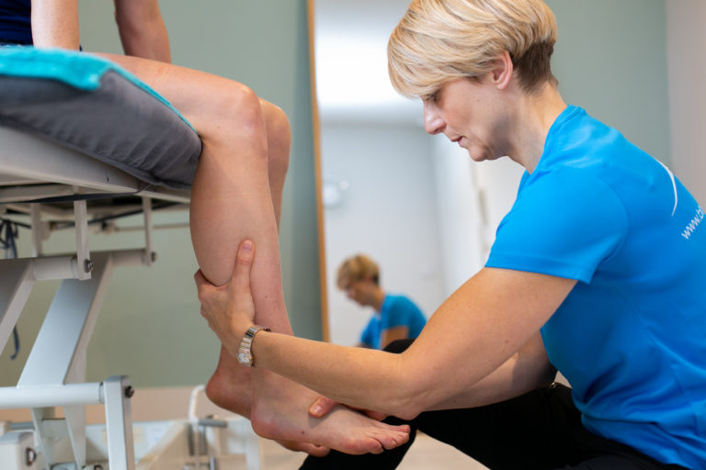

Practice Safely and Effectively:
Stay within your knowledge and scope of practice (HCPC, 2014).
Seek help or guidance when needed to ensure patient safety.
Example:
  Speak up if unsure about a treatment or request clarification from your educator.
  Contacting your PE when unsure about anything.

Slide 9


Promote and Protect the Interests of Others
Respect patient dignity and involve them in decision-making.
Practice inclusivity and avoid discrimination (CSP, 2011).
Example:
  Adapt assessments to accommodate individual patient needs, such as cultural preferences or mobility restrictions.

Slide 10



Risk Assessment and Reporting
Assess risks and take steps to limit harm to yourself, patients, and colleagues.
Report any safety concerns promptly to your practice educator (HCPC, 2014).
Example:
  Identify trip hazards before mobilizing a patient.
  Regular breaks form computer, ensure computer set-up is ergonomically friendly

Slide 11


Confidentiality and Professional Boundaries
Maintain patient confidentiality in all settings.
Avoid discussing patient details in public or on social media (HCPC, 2023).
Example:
  Be mindful of what is shared during discussions outside of the clinical setting.
  Discussing concerns with PE.

Slide 12


Dress Code and Punctuality
Follow organizational standards for dress, appearance, and hygiene.
Ensure you are punctual and prepared for placement activities (CSP, 2011).
Example:
  Arrive on time with necessary materials and be dressed according to placement site protocols.
  Making sure that hair is tied back and does not cover your face

Slide 13
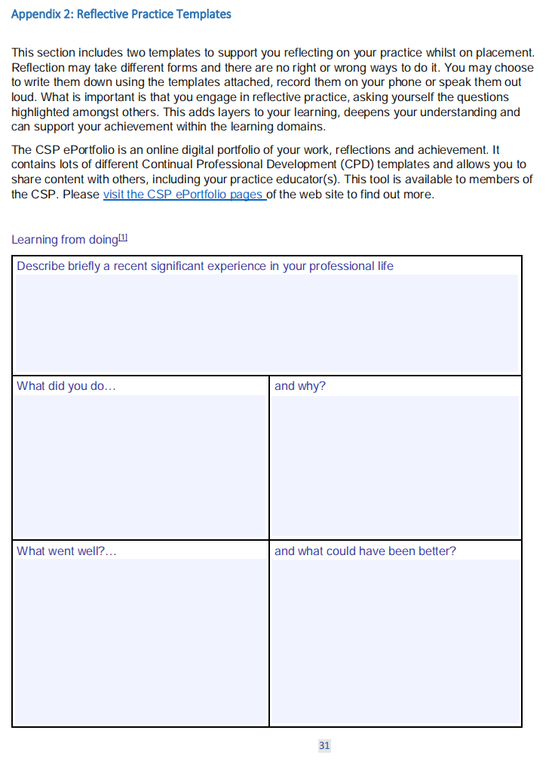
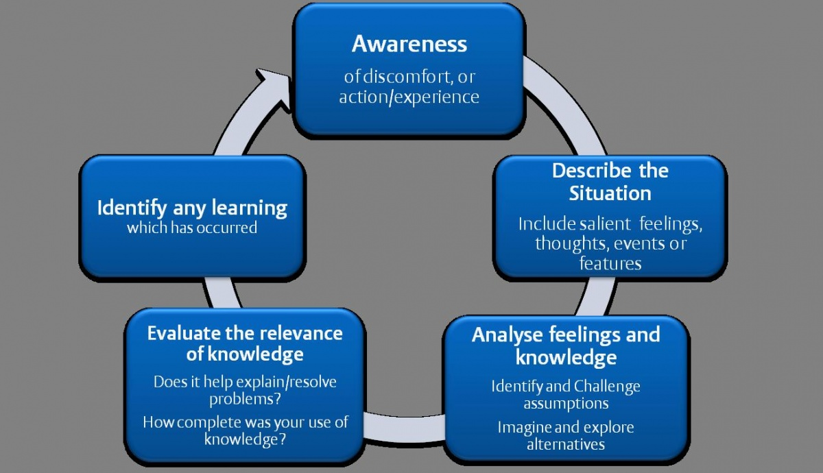
Continuous Self-Reflection
Use feedback and self-reflection to improve professional behaviour.
Engage in reflective practice to identify areas for growth (Gibbs, 1988).
Example:
  Reflect on feedback received during clinical sessions and apply it in future practices.

Slide 14
How Professionalism is Assessed in Physiotherapy Placements
Assessment Tool: The Common Placement Assessment Form (CPAF) is used to evaluate student professionalism.
Key Domains: Professionalism is assessed under various domains such as communication, ethical practice, patient confidentiality, and teamwork (HCPC, 2023).
Feedback from Educators: Practice educators provide ongoing feedback on professional behaviour throughout the placement.
Midway and Final Assessments: Professionalism is formally evaluated at the midway and final points of placement to ensure students meet required standards.
Pass/Fail Criteria: Students must demonstrate professional behaviour to meet the minimum threshold for passing the placement.
Example:
  Maintaining patient confidentiality, showing respect, and adhering to dress codes are essential behaviours that educators assess during placement.

Slide 15
References:
Chartered Society of Physiotherapy (CSP), 2011. Code of Professional Values and Behaviour. [online] Available at: https://www.csp.org.uk/publications/code-professional-values-behaviour [Accessed 7 September 2024].
Health and Care Professions Council (HCPC), 2014. Standards of Education and Training. [online] Available at: https://www.hcpc-uk.org/standards/standards-of-education-and-training/ [Accessed 7 September 2024].
Health and Care Professions Council (HCPC), 2023. Standards of Conduct, Performance and Ethics. [online] Available at: https://www.hcpc-uk.org/standards/standards-of-conduct-performance-and-ethics/ [Accessed 7 September 2024].
Gibbs, G., 1988. Learning by Doing: A Guide to Teaching and Learning Methods.

